Slide 1


Slide 2
Application of Stacks
Sorting Algorithms
Insertion, selection and bubble sort have quadratic worst-case performance
The faster comparison based algorithm ?
O(nlogn)
Quicksort and Mergesort

Slide 3
QUICK SORT
Quicksort is an algorithm of the divide-and-conquer type. That is, the problem of sorting a set is reduced to the problem of sorting two smaller sets.

Slide 4
QUICK SORT
We Illustrate this “reduction step” by means of a specific example.
Suppose A is the following list of 12 numbers
44, 33, 11, 55, 77, 90, 40, 60, 99, 22, 88, 66

Slide 5
44, 33, 11, 55, 77, 90, 40, 60, 99, 22, 88, 66
The reduction step of the quicksort algorithm finds the final position of one of the numbers (known as pivot element); in this illustration, we use the first number, 44 as pivot. This is accomplished as follows.
Beginning with the last number, 66, scan the list from right to left, comparing each number with 44 and stopping at the first number less than 44. The number is 22. Interchange 44 and 22 to obtain the list.
22, 33, 11, 55, 77, 90, 40, 60, 99, 44, 88, 66

Slide 6
Observe that the numbers 88 and 66 to the right of 44 are each greater than 44.
22, 33, 11, 44, 77, 90, 40, 60, 99, 55, 88, 66
22, 33, 11, 40, 77, 90, 44, 60, 99, 55, 88, 66
22, 33, 11, 40, 44, 90, 77, 60, 99, 55, 88, 66
22, 33, 11, 40, 44, 90, 77, 60, 99, 55, 88, 66

Slide 7
Consider the above list A with n = 12 elements. The algorithm begins by pushing the boundary values 0 and 11 of ‘A’ onto the stacks to yield
LOWER : 0 UPPER : 11
In order to apply the reduction step, the algorithm first removes the top values 0 and 11 from the stacks, leaving
LOWER : (empty) UPPER : (empty)
and then applies the reduction step to the corresponding list A[0], A[1], ….A[11]. The reduction step, as executed above, finally places the first element, 44, in A[4]. Accordingly, the algorithm pushes the boundary values 0 and 3 of the first sublist and the boundary values 5 and 11 of the second sublist onto the stacks to yield
LOWER :0, 5 UPPER : 3, 11

Slide 8
In order to apply the reduction step again, the algorithm removes the top values, 5 and 11, from the stacks, leaving
LOWER : 0 UPPER : 3
And then applies the reduction step to the correponding sublist A[5], A[6], …..A[11]. The reduction step changes this list accordingly.

Slide 9
Quicksort
This algorithm sorts an array A with N elements.
[Initialize] TOP = NULL.
If N > 1, then; TOP = TOP + 1, LOWER[TOP] = 0,
UPPER[TOP] = N-1.
3. Repeat Steps 4 to 7 while TOP ≠ NULL.
4. Set BEG = LOWER[TOP], END = UPPER[TOP], TOP = TOP – 1.
5. Call REDUCTION(A, N, BEG, END).
6. If BEG < LOC - 1, then:
TOP = TOP + 1, LOWER[TOP] = BEG,
UPPER[TOP] = LOC – 1.
If LOC + 1 < END, then:
TOP = TOP + 1, LOWER[TOP] = LOC + 1,
UPPER[TOP] = END.
8. Exit.

Slide 10
REDUCTION(A, N, BEG, END)
Here A is an array with N elements. Parameters BEG and END contain the boundary values of the sublist of A to which this procedure applies. LOC keeps track of the position of the first element A[BEG] of the sublist during the procedure. The local variables LEFT and RIGHT will contain the boundary values of the list of elements that have not been scanned.
[Initialize] Set LEFT = BEG; RIGHT = END AND LOC = BEG.
[Scan from right to left.]
(a) Repeat while A[LOC] ≤ A[RIGHT] and LOC ≠ RIGHT :
RIGHT = RIGHT – 1.
(b) If LOC = RIGHT, then: Return.
(c) If A[LOC] > A[RIGHT], then:
(i) [Interchange A[LOC] and A[RIGHT].]
TEMP = A[LOC], A[LOC] = A[RIGHT],
A[RIGHT] = TEMP.
(ii) Set LOC = RIGHT.
(iii) Go to Step 3.

Slide 11
QUICK(A, N, BEG, END, LOC)
3. [Scan from left to right.]
(a) Repeat while A[LEFT] ≤ A[LOC] and LEFT ≠ LOC :
LEFT = LEFT + 1.
(b) If LOC = LEFT, then: Return.
(c) If A[LEFT] > A[LOC], then:
(i) [Interchange A[LEFT] and A[LOC].]
TEMP = A[LOC], A[LOC] = A[LEFT],
A[LEFT] = TEMP.
(ii) Set LOC = LEFT.
(iii) Go to Step 2.

Slide 12
Complexity of Quicksort
In an average case, each reduction step of the algorithm produces 2 sublists. Accordingly:
Reducing the initial list places 1 element and produces 2 sublists.
Reducing the 2 sublists places 2 elements and produces 4 sublists.
Reducing the 4 sublists places 4 elements and produces 8 sublists.
Reducing the 8 sublists places 8 elements and produces 16 sublists.
And so on. Observe that the reduction step in the k^{th} level finds the location of 2^{k-1} elements; hence there will be approximately log₂n levels of reduction steps. Furthermore, each level uses atmost n comparisons, so f(n) = O(n log n).

Slide 13
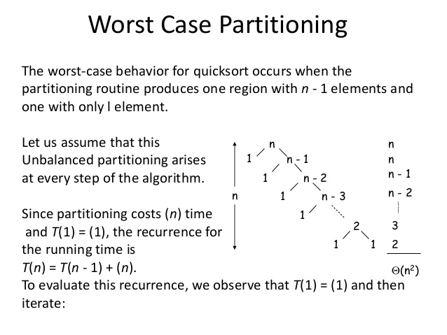

Slide 14
Recursive Quicksort
void main()
{
int n, i;
printf("Enter the size of array");
scanf("%d",&n);
int array[n];
printf("Enter the elements of array : ");
for(i = 0; i < n; i++)
scanf("%d", &array[i]);
quicksort(array, 0, n-1);
printf("Sorted array is: ");
for(i=0; i<n; i++)
printf(" %d", array[i]);
}

Slide 15
void quicksort(int array[], int beg, int end)
{
int loc, temp, left, right;
if(beg < end)
{
loc = beg;
left = beg;
right = end;
while(left < right)
{
while(array[loc] <= array[right] && loc < right)
right--;
while(array[loc]>array[left])
left++;
if(array[loc]>array[right])
{
temp = array[loc];
array[loc] = array[right];
array[right] = temp;
loc = right;
}

Slide 16
if(array[loc]<array[left])
{
temp = array[loc];
array[loc] = array[left];
array[left] = temp;
loc = left;
}
}
quicksort(array, beg, loc-1);
quicksort(array, loc+1, end);
}
}

